Slide 1

Everest Group is a global research and consulting firm that helps organizations improve their financial,
operational, and digital performance through data-driven insights.
The company provides strategic analysis across functions like finance, supply chain, IT, HR,
and global business services.

Slide 2
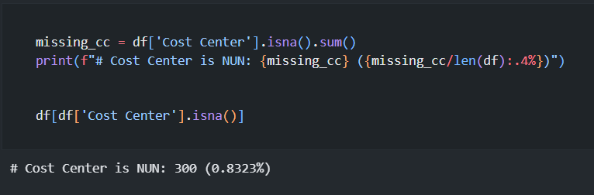
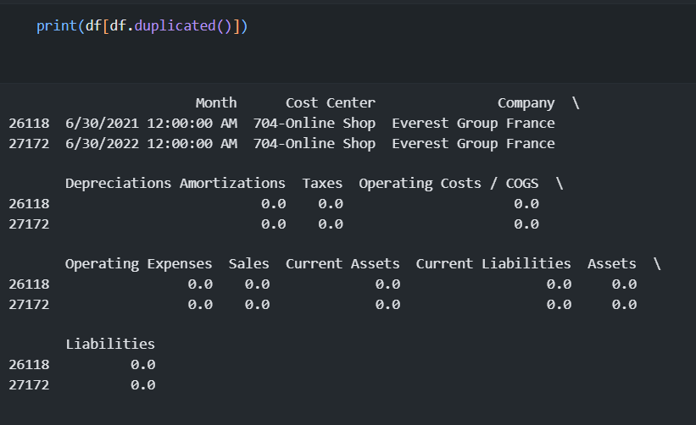
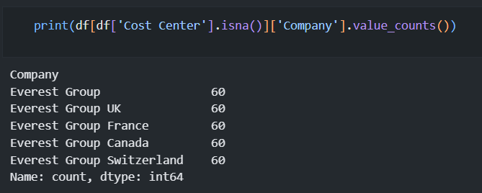

Slide 3
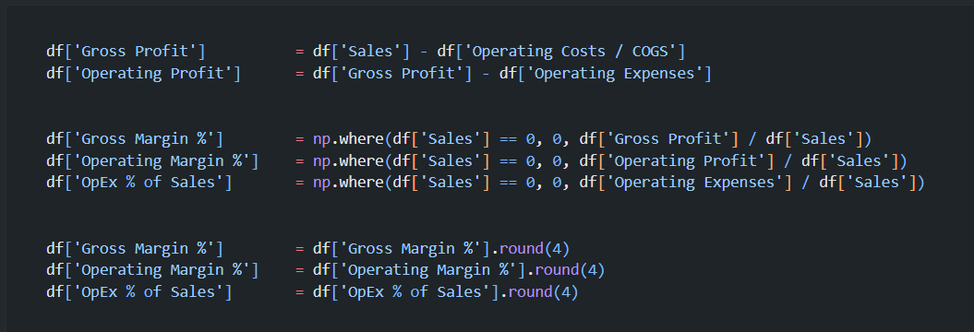

Slide 4
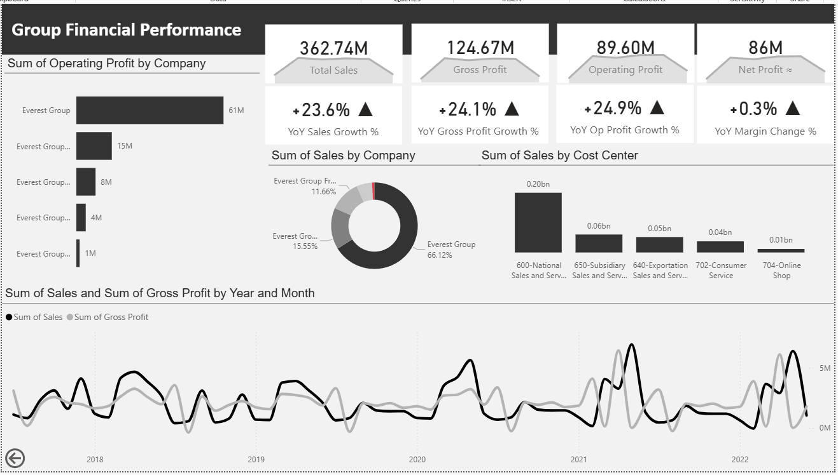

Slide 5
